Slide 1



Jaypee University of Information Technology, Waknaghat - 173234 (India)
Minor Project (18B19CI691) | AY 2025-26
Mid-Term Evaluation | March 16-21, 2026.
Stress Management System using Facial Recognition
Group No.: 32
Team Members
Supervisor
Name: Dr. Monika Department: CSE & IT
Abhiuday Pratap Singh (231031005)
Devanshu Saroha (231030153)
Sameeksha Shakya (231030002)
Shivansh Sharma (231030171)

Slide 2
Outline
Introduction
Problem Statement
Project Objectives
Literature review
Project Design
Implementation
Experimental Results and Evaluation
Future work (till End-Term Evaluation)
Work Contribution
References

Slide 3
Introduction
Mental stress has become a significant issue among students and professionals due to increasing academic pressure, workload, and lifestyle imbalance. Traditional stress detection methods rely on surveys or clinical evaluation, which are often time-consuming and subjective.
Recent advancements in machine learning and computer vision enable automated systems to analyze behavioral and facial signals to estimate stress levels.
This project proposes an AI-based Stress Management System that integrates:
Behavioural routine analysis
Facial feature extraction
Emotion detection
Machine learning classification
The system predicts stress levels and generates personalized stress-management recommendations.
Notes:
Note the “ AI “ mentioned here is a Local LLM, which we are using to convert SHAP explanations to humanized explanations.

Slide 4
Problem Statement
Mental stress is difficult to detect at an early stage because it is influenced by multiple behavioural and emotional factors. Existing stress detection systems are limited in scope, as they typically rely on a single source such as physiological sensors, questionnaires, or emotion detection techniques, which may not provide a complete understanding of an individual’s mental state.
To address these limitations, there is a need for an integrated system that combines behavioural lifestyle data with facial emotional cues to improve accuracy. Such a system should not only predict stress levels but also provide interpretable results and meaningful insights. This project proposes a hybrid AI-based stress intelligence system that analyzes multiple signals to estimate stress levels and explain the contributing factors effectively.
Notes:
Holistic: considered as a whole thing rather than a collection of parts.

Slide 5
Project Objectives
The primary objectives of this project are:
To develop a machine learning model capable of predicting stress levels.
To integrate behavioral routine data and facial emotional signals.
To implement real-time facial feature extraction using computer vision.
To use Explainable AI techniques to interpret model predictions.
To generate personalized cognitive reports using a local Large Language Model.
To build an interactive user interface for stress monitoring and analysis.

Slide 6
Literature Review(1)
Authors [Ref.] | Title/Year | Method (Approach) | Work Done | Advantages | Limitations
Zhang et al. [1] | Multimodal Stress Detection (2022) | CNN + Multimodal Fusion | Combined facial expressions with physiological signals (ECG, etc.) for stress prediction | Higher accuracy due to multiple data sources | Requires sensors and complex data collection
Kaur et al. [2] | EmpathicSchool (2025) | Dataset + AI Models | Created student-focused stress dataset and applied AI models | Real-world dataset improves relevance | Limited to specific environment
Sharma et al. [3] | Facial Stress Detection (2024) | CNN | Detected stress using facial expressions only | Easy to implement, no extra hardware | Sensitive to lighting and face angle
Wang et al. [4] | Stress via FER (2024) | Deep Learning (CNN) | Mapped facial emotions to stress levels | Good classification accuracy | Emotions may not always indicate stress

Slide 7
Literature Review(2)
Authors [Ref.] | Title/Year | Method (Approach) | Work Done | Advantages | Limitations
Patel et al. [5] | Compound Expressions (2024) | CNN | Used complex facial expression combinations for detection | Captures subtle emotional patterns | Computationally expensive
Kim et al. [6] | Real-time Stress (2025) | CNN + Real-time Processing | Developed system for live stress detection via camera | Instant results, practical usage | Needs good hardware and camera quality
Hochreiter et al. [7] | CNN-LSTM Model (2020) | CNN + LSTM | Combined spatial + temporal features for emotion tracking | Captures changes over time | Model complexity is high
Mollahosseini et al. [8] | Affect Analysis (2021) | Deep Learning | Emotion detection in real-world (uncontrolled) environments | Works in real-life scenarios | Noisy data reduces accuracy

Slide 8
Literature Review(3)
Authors | Title/Year | Method (Approach) | Work Done | Advantages | Limitations
Saini et al. [9] | ML Stress Detection (2024) | SVM, Random Forest | Applied traditional ML models on stress datasets | Simple and fast implementation | Less accurate than deep learning
Saeb et al. [10] | Smartphone Stress (2025) | Sensors + ML | Used mobile sensor data (activity, usage) for stress prediction | Passive monitoring without user effort | Privacy concerns
Li & Deng [11] | FER Survey (2024) | Review Study | Reviewed multiple deep learning emotion recognition methods | Strong theoretical understanding | No practical implementation
Ekman & Friesen [12] | Action Unit Stress (2024) | Facial Action Units + ML | Used facial muscle movements for stress detection | Detailed and fine-grained analysis | Complex feature extraction

Slide 9
Research Gap
Key Observations:
Physiological systems require specialized hardware.
Emotion detection systems analyze facial expressions but do not directly predict stress.
Behavioural datasets focus on lifestyle factors but ignore emotional signals.
Most existing approaches rely on a single data source.
Our project proposes a multimodal system that combines behavioural data and facial analysis to predict stress.

Slide 10
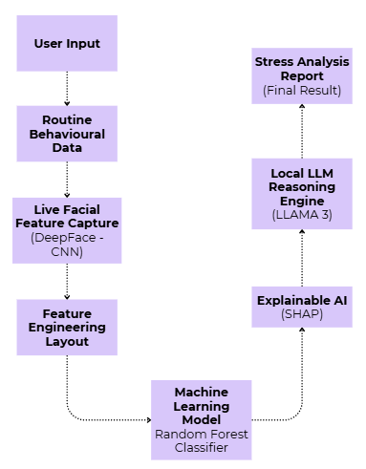
Project Design (System Architecture)
Fig: System Architecture

Slide 11
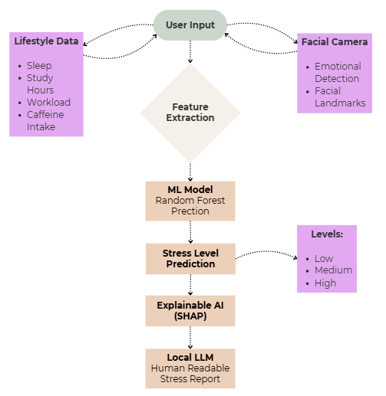
Project Design (System Workflow)
Fig: System Workflow

Slide 12
Implementation (Dataset)
Dataset Description
Real-world dataset: Student Stress Monitoring Dataset
Contains ~1100 student records with behavioural and psychological indicators
Target variable: Stress Level
Key Features:
1. Behavioural & Lifestyle
Sleep quality
Study hours
Academic pressure
Social support
Screen time
2. Psychological Indicators
Anxiety level
Self-esteem
Depression indicators
3. Stress Classes
Low Stress
Moderate Stress
High Stress
Dataset Source:
Kaggle – Student Stress Monitoring Dataset [13]

Slide 13
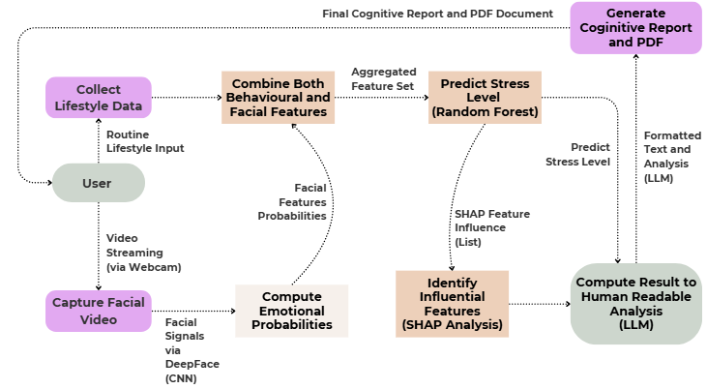
Implementation (Data Flow)
Fig: Data Flow Diagram

Slide 14
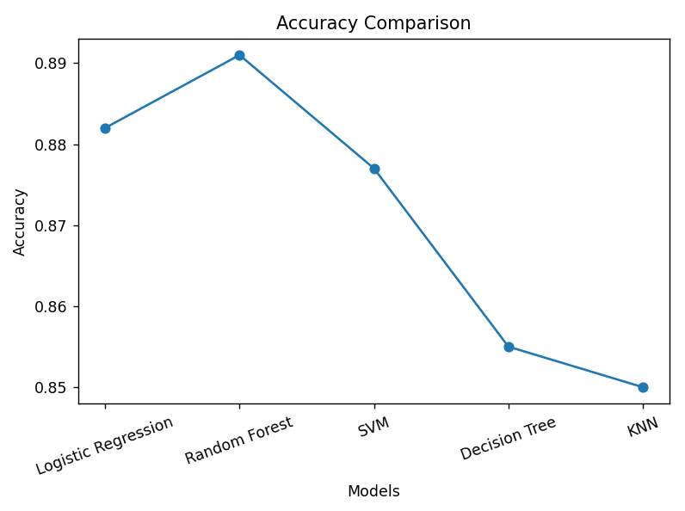
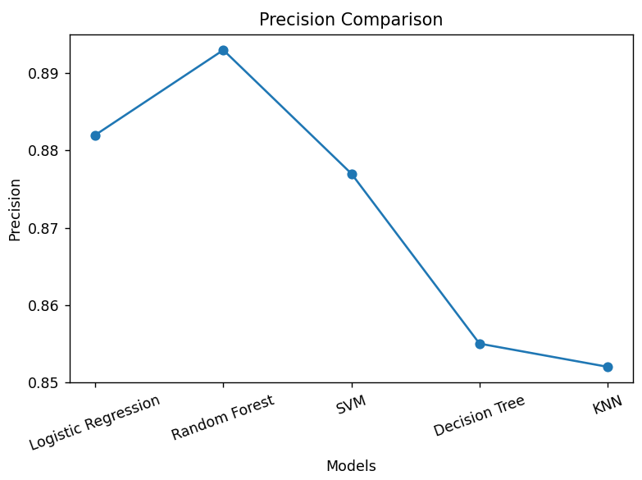
Implementation (Machine Learning)

Slide 15
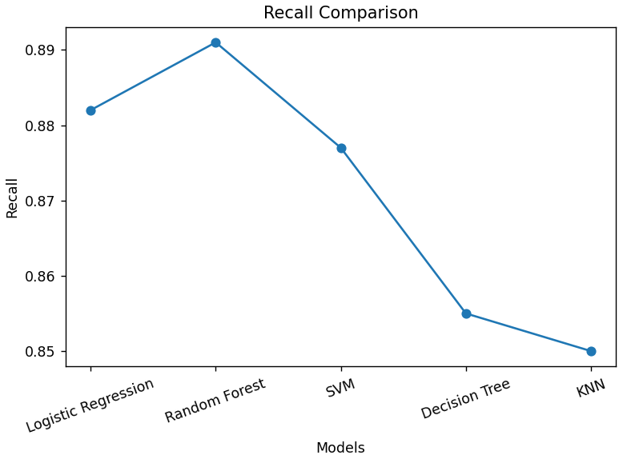

Implementation (Machine Learning)

Slide 16
Implementation (Machine Learning)
Table 1: Performance Comparison of Various Models
Model | Accuracy | Precision | Recall | F1 Score | ROC-AUC
Logistic Regression | 0.882 | 0.882 | 0.882 | 0.882 | 0.965
Random Forest | 0.891 | 0.893 | 0.891 | 0.891 | 0.983
Support Vector Machine (SVM) | 0.877 | 0.877 | 0.877 | 0.877 | 0.974
Decision Tree | 0.855 | 0.855 | 0.855 | 0.855 | 0.891
K-Nearest Neighbors (KNN) | 0.850 | 0.852 | 0.850 | 0.850 | 0.953

Slide 17
Experimental Results and Evaluation
Key Observation
Random Forest achieved the highest classification accuracy (0.891).
Logistic Regression and SVM also showed strong performance with similar scores.
Decision Tree and KNN performed slightly lower due to weaker generalization.
Ensemble methods such as Random Forest handle nonlinear feature relationships effectively, making them suitable for stress prediction.
Selected Model: Random Forest Classifier
Why Random Forest was selected:
Random forest handles nonlinear relationships
It also works well with mixed features
It has a Robust and stable performance across different data samples.
In summary, Random Forest achieved the highest accuracy and was selected as the final model due to its strong performance and ability to handle nonlinear relationships.

Slide 18
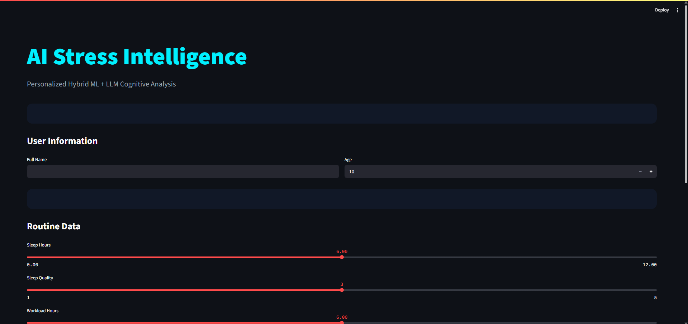
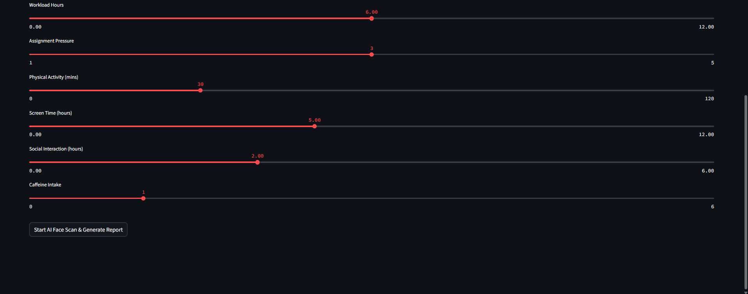
Prototype - UI

Slide 19
Experimental Analysis
The experimental results demonstrate that machine learning models can effectively classify stress levels based on behavioural and emotional features.
Key findings:
Random Forest achieved the highest classification accuracy among the evaluated models.
Behavioural features such as sleep and workload significantly affect stress levels.
Emotion features extracted from facial analysis provide additional context for prediction.
Random Forest provides useful feature importance for explaining predictions.
These results validate the feasibility of the proposed multimodal stress detection system.

Slide 20
Future Work (till End-Term Evaluation)
In the remaining phase of the project, the following tasks will be completed to finalize the Stress Management System.
Real-Time Stress Prediction System A live prediction system will be implemented that allows users to enter routine data and capture facial signals.
Explainable AI for Stress Factors Feature importance analysis will be incorporated to identify the main factors contributing to stress.
Stress Management Recommendation Engine A rule-based recommendation module will be implemented to provide suggestions such as improving sleep habits, reducing screen time, or performing relaxation exercises.
User Interface Development A simple user interface will be developed to allow users to input routine information, capture facial images, and view stress predictions and recommendations.
Final System Testing and Optimization The complete system will be tested using multiple scenarios to verify prediction accuracy, module integration, and overall system performance before final project submission.

Slide 21
Work Contribution
S no. | Name and Roll No. | Work Done | Work Contribution (%) | No. of Literature Read | Implementation
1 | Abhiuday Pratap Singh 231031005 | ML pipeline design, model training, and evaluation. | 30% | 4 | ML models and prediction pipeline
2 | Sameeksha Shakya 231030002 | Facial landmark detection and emotion analysis research. | 25% | 4 | Facial feature extraction module
3 | Devanshu Saroha 231030153 | System workflow design and module integration. | 25% | 4 | UI flow and system integration
4 | Shivansh Sharma 231030171 | Dataset design, validation, and documentation. | 20% | 4 | Dataset preparation and management

Slide 22
References
[1] Zhang, Y. et al., “Multimodal Stress Detection Using Deep Learning,” 2022.
https://www.frontiersin.org/articles/10.3389/fnins.2022.947168
[2] Kaur, S. et al., “EmpathicSchool: A Dataset for Student Stress Analysis,” 2025.
https://www.nature.com/articles/s41597-025-05812-0
[3] Sharma, A. et al., “Facial Expression-Based Stress Detection Using CNN,” 2024.
https://journalspub.com
[4] Wang, H. et al., “Emotion Recognition for Stress Analysis,” 2024.
[5] Patel, D. et al., “Compound Facial Expression Analysis for Stress Detection,” 2024.
[6] Kim, J. et al., “Real-Time Stress Detection System Using Deep Learning,” 2025.
[7] Hochreiter, S. et al., “CNN-LSTM for Emotion Recognition,” 2020.
[8] Mollahosseini, A. et al., “AffectNet: A Database for Emotion Recognition,” 2021.
[9] Saini, R. et al., “Machine Learning-Based Stress Detection,” 2024.
[10] Saeb, S. et al., “Mobile Sensing for Stress Detection,” 2025.
[11] Li, S. and Deng, W., “Deep Facial Expression Recognition: A Survey,” 2024.
[12] Ekman, P. and Friesen, W., “Facial Action Coding System (FACS),” Updated Applications, 2024.

Slide 23
References
[13] Dataset: student-stress-monitoring-datasets link: https://www.kaggle.com/datasets/mdsultanulislamovi/student-stress-monitoring-datasets?resource=download
[14] Lundberg, S.M. and Lee, S., “A Unified Approach to Interpreting Model Predictions (SHAP),” 2017.
https://arxiv.org/abs/1705.07874
[15] Taigman, Y. et al., “DeepFace: Closing the Gap to Human-Level Performance,” 2014.
[16] Wang, R. et al., “StudentLife: Assessing Mental Health using Smartphones,” 2014.
[17] Fawcett, T., “An Introduction to ROC Analysis,” 2006.

Slide 24
Thank You.

